Slide 1

LET US C
BY YASHAVANT KANETKAR
CH 9 Q[C]
CH 9 Q[A]
CH 9 Q[B]
CHAPTER 9 SOLUTIONS
POINTERS

Slide 2
CHAPTER 9 SOLUTIONS
POINTERS
Q[A] What will be the output of the following programs:
CH 9 Q[A]
#include <stdio.h>
void fun ( int, int);
int main()
{
int i = 5, j = 2;
fun (i, j);
printf("%d %d\n", i, j);
return 0;
}
void fun (int i, int j)
{
i = i*i;
j = j*j;
}
(a)
(b)
CH 9 Q[C]
CH 9 Q[B]
(c)
DEAR CODING
BOOK: LET US C
BY YASHAVANT KANETKAR

Slide 3

CHAPTER 9 SOLUTIONS
POINTERS
(a)
#include <stdio.h>
void fun ( int, int);
int main()
{
int i = 5, j = 2;
fun (i, j);
printf("%d %d\n", i, j);
return 0;
}
void fun (int i, int j)
{
i = i*i;
j = j*j;
}
👩‍💻 Output:
CH 9 Q[A](a)
✍️ The value of i and j variables in main() function are COPIED in the parameters of fun() function. Now any changes to i and j in function fun() doesn’t affect i and j in main().
DEAR CODING
BOOK: LET US C
BY YASHAVANT KANETKAR

Slide 4

CHAPTER 9 SOLUTIONS
POINTERS
(b)
#include <stdio.h>
void fun (int *, int *);
int main()
{
int i = 5, j = 2;
fun (&i, &j);
printf("%d %d\n", i, j );
return 0;
}
void fun (int *i, int *j)
{
*i = *i * *i;
*j = *j * *j;
}
👩‍💻 Output:
CH 9 Q[A](b)
✍️ This is an example of call by reference. The address of I and j variables in main function are passed into fun function. Using these addresses, fun function has access to the I and J variables in the main function and hence it would be able to manipulate them.
DEAR CODING
BOOK: LET US C
BY YASHAVANT KANETKAR

Slide 5
CHAPTER 9 SOLUTIONS
POINTERS
(c)
#include <stdio.h>
int main()
{
float a = 13.5;
float *b, *c;
b = &a; /* suppose address of a is 1006 */
c = b;
printf("%u %u %u\n", &a, b, c);
printf("%f %f %f %f %f\n", a, *(&a), *&a, *b, *c);
return 0;
}
✍️ & -> address of
* -> value at address
CH 9 Q[A](c)
DEAR CODING
👩‍💻 Output:
BOOK: LET US C
BY YASHAVANT KANETKAR

Slide 6
CHAPTER 9 SOLUTIONS
POINTERS
Q[B] Find out the errors, if any, in the following program:
CH 9 Q[B]
#include <stdio.h>
void pass (int, int);
int main() {
int i = 135, a = 135, k;
k = pass (i, a);
printf("%d\n", k);
return 0;
}
void pass (int j, int b)
int c;
{
c = j + b;
return (c);
}
(q)
(b)
CH 9 Q[C]
CH 9 Q[B]
(c)
(d)
DEAR CODING
BOOK: LET US C
BY YASHAVANT KANETKAR

Slide 7


CHAPTER 9 SOLUTIONS
POINTERS
(a)
#include <stdio.h>
void pass (int, int);
int main() {
int i = 135, a = 135, k;
k = pass (i, a);
printf("%d\n", k);
return 0;
}
void pass (int j, int b)
int c;
{
c = j + b;
return (c);
}
CH 9 Q[B](a)
✍️ A void function cannot be assigned to a variable.
✍️ Variables cannot be declared in b/w the function name and its body.
✍️ A void function does not return anything.
DEAR CODING
BOOK: LET US C
BY YASHAVANT KANETKAR

Slide 8
CHAPTER 9 SOLUTIONS
POINTERS
(b)
#include <stdio.h>
void jiaayjo (int, int)
int main()
{
int p = 23, f = 24;
jiaayjo ( &p, &f);
printf("%d %d\n", p, f);
return 0;
}
void jiaayjo (int q, int g) {
q = q + q;
g = g + g;
}
CH 9 Q[B](b)
❌
ERROR!
✍️ ; Is missing at the end of prototype declaration of the function jiaayjo.
DEAR CODING
BOOK: LET US C
BY YASHAVANT KANETKAR

Slide 9
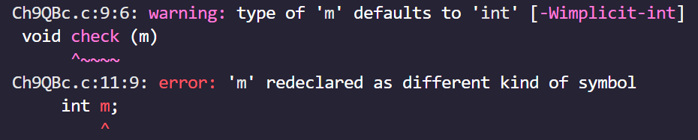
CHAPTER 9 SOLUTIONS
POINTERS
(c)
#include <stdio.h>
int main()
{
int k = 35, z;
z = check(k);
printf("%d\n", z);
return 0;
}
void check (m)
{
int m;
if (m > 40)
return (1);
else
return (0);
}
CH 9 Q[B](c)
✍️ A void function cannot be assigned to a variable.
✍️ Type of variable m is not mentioned. By default, the compiler will treat m as an integer variable.
✍️ m variable is redeclared.
✍️ A void function does not return anything.
DEAR CODING
BOOK: LET US C
BY YASHAVANT KANETKAR

Slide 10
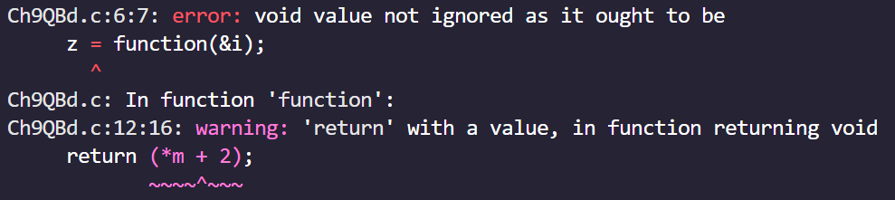
CHAPTER 9 SOLUTIONS
POINTERS
(d)
#include <stdio.h>
void function (int *);
int main()
{
int i = 35, *z;
z = function(&i);
printf("%d\n", z);
return 0;
}
void function (int *m)
{
return (*m + 2);
}
CH 9 Q[B](d)
✍️ A void function cannot be assigned to a variable.
✍️ A void function does not return anything.
DEAR CODING
BOOK: LET US C
BY YASHAVANT KANETKAR

Slide 11
CHAPTER 9 SOLUTIONS
POINTERS
(a) Write a function that receives 5 integers and returns the sum, average and standard deviation of these numbers. Call this function from main() and print the results in main().
CH 9 Q[D](a)
DEAR CODING
BOOK: LET US C
BY YASHAVANT KANETKAR

Slide 12
CHAPTER 9 SOLUTIONS
POINTERS
(b) Write a function that receives marks received by a student in 3 subjects and returns the average and percentage of these marks. Call this function from main() and print the results in main().
CH 9 Q[D](b)
DEAR CODING
BOOK: LET US C
BY YASHAVANT KANETKAR

Slide 13
CHAPTER 9 SOLUTIONS
POINTERS
(c) Write a C function to evaluate the series
sin(x)=x-(x³/3!)+(x⁵/5!) - (x⁷/7!) + ... up to 10 terms.
CH 9 Q[D](c)
DEAR CODING
BOOK: LET US C
BY YASHAVANT KANETKAR

Slide 14
CHAPTER 9 SOLUTIONS
POINTERS
(d) Given three variables x, y, z write a function to circularly shift their values to right. In other words, if x = 5, y = 8, z= 10, after circular shift y = 5, z = 8, x =10. Call the function with variables a, b, c to circularly shift values.
CH 9 Q[D](c)
DEAR CODING
BOOK: LET US C
BY YASHAVANT KANETKAR

Slide 15
CHAPTER 9 SOLUTIONS
POINTERS
(e) If the lengths of the sides of a triangle are denoted by a, b, and c then area of triangle is given by
area = √S(S-a)(S-b)(S-c)
where, S = (a+b+c)/2. Write a function to calculate the area of the triangle.
CH 9 Q[D](e)
DEAR CODING
BOOK: LET US C
BY YASHAVANT KANETKAR

Slide 16
CHAPTER 9 SOLUTIONS
POINTERS
(f) Write a function to compute the distance between two points and use it to develop another function that will compute the area of the triangle whose vertices are A(x1,y1), B(x2, y2), and C(x3, y3). Use these functions to develop a function which returns a value 1 if the point (x, y) lies inside the triangle ABC, otherwise returns a value 0.
CH 9 Q[D](e)
DEAR CODING
BOOK: LET US C
BY YASHAVANT KANETKAR

Slide 17
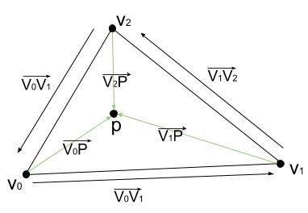
CHAPTER 9 SOLUTIONS
POINTERS
CH 9 Q[D](e)
DEAR CODING
BOOK: LET US C
BY YASHAVANT KANETKAR

Slide 18
CHAPTER 9 SOLUTIONS
POINTERS
(f) Write a function to compute the greatest common divisor given by Euclid's algorithm, exemplified for
J = 1980, K = 1617 as follows:
1980/1617 = 1 1980-1*1617 = 363
1617/363 = 4 1617-4*363 = 165
363 /165 = 2 363-2*165 = 33
5/33 = 5 165-5*33= 0
Thus, the greatest common divisor is 33.
CH 9 Q[D](e)
DEAR CODING
BOOK: LET US C
BY YASHAVANT KANETKAR

Slide 19
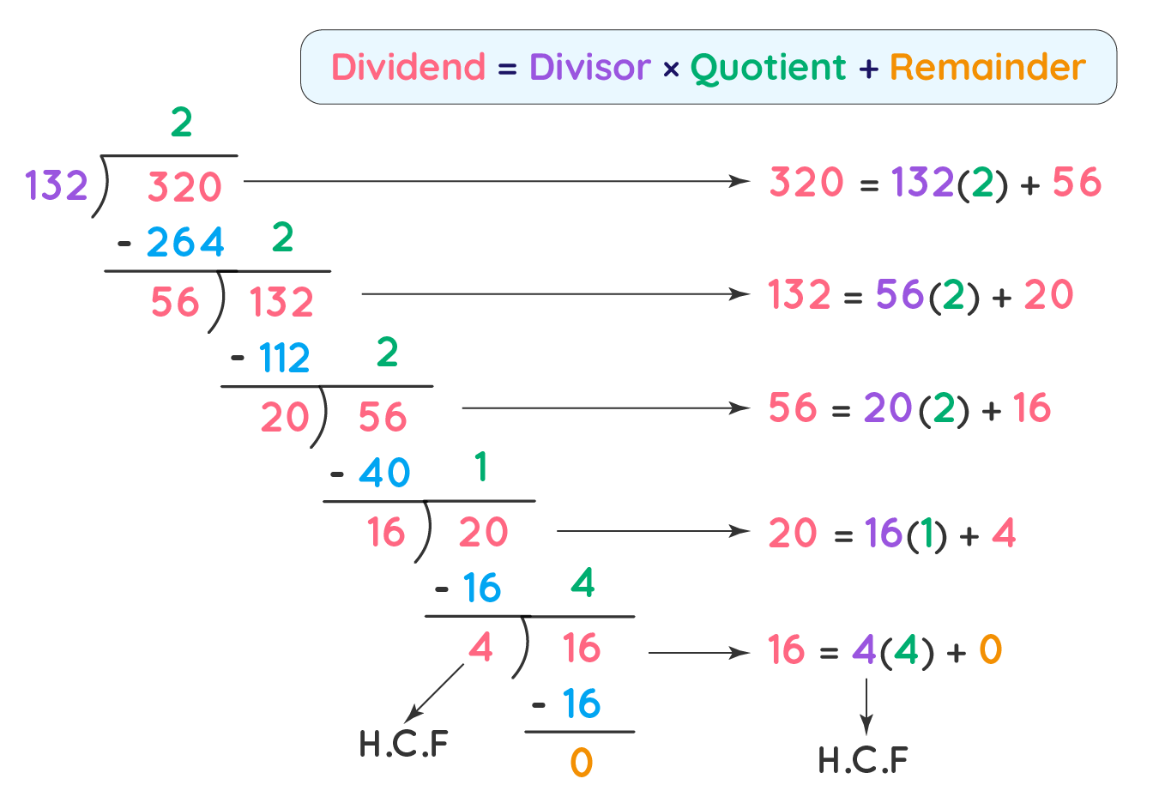
CHAPTER 9 SOLUTIONS
POINTERS
CH 9 Q[D](e)
DEAR CODING
BOOK: LET US C
BY YASHAVANT KANETKAR

Slide 20
LET US C
BY YASHAVANT KANETKAR
CH 10 Q[B]
CH 10 Q[A]
CHAPTER 10 SOLUTIONS
RECURSION

Slide 21


🔴Let me create amazing coding tutorials for you forever!🙂
👇👇👇👇👇👇👇👇👇👇👇👇👇👇👇👇👇👇
👉 SUBSCRIBE 🤛
CH 10 Q[B]
CHAPTER 10 SOLUTIONS
RECURSION
CH 10 Q[A]
Thanks for your valuable time!

Slide 22
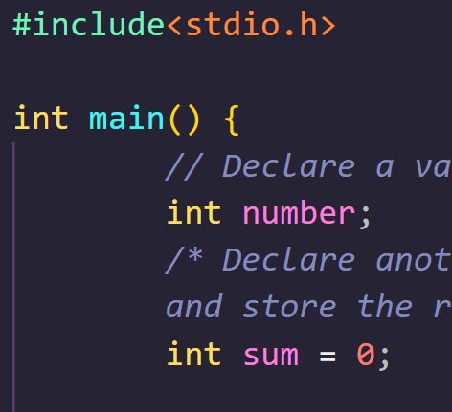
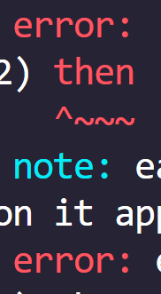

DEAR CODING

